Slide 1

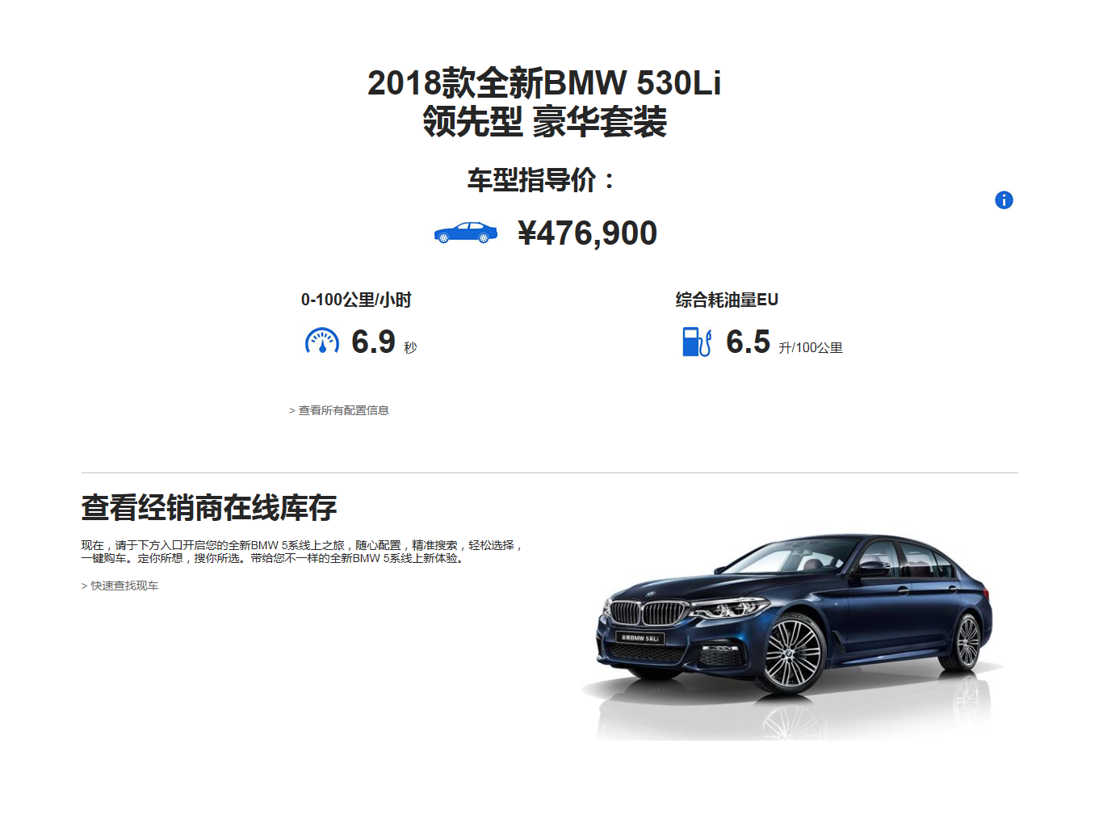
Electronic Standee Page 1
Cover page is BMW Official Website
Click to open Spec Sheet
Click to open Page 2
Demo page URL: http://www.bmw.com.cn/content/dam/bmw/marketCN/campaign/2018/g38_app/overview.html
Notes:
(..)

Slide 2
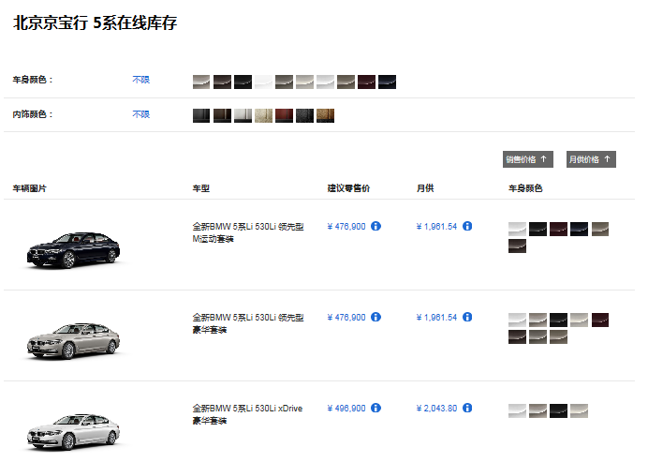

Electronic Standee Page 2
Dealer New Car Online Stock List
Filter
Sort
Click to open Page 3
Back to Cover Page
Demo Page Prototype: https://bmwnewcar.bmw.com.cn/quicksearch/c/quicksearch/search?cityCode=&provinceCode=&sSeries=5&modelPriceStart=&modelPriceEnd=&from=index-search-5-0_-0
Notes:
(..)

Slide 3
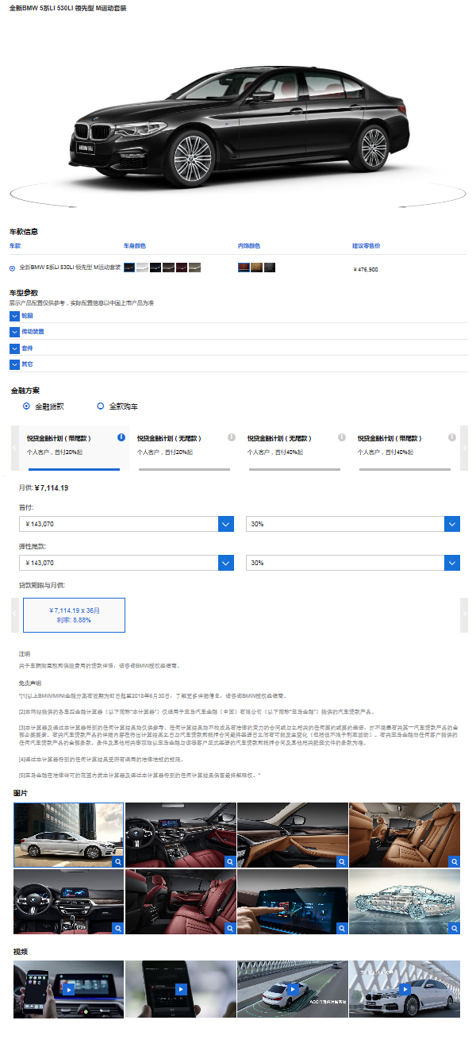
Electronic Standee Page 3
360° View
Color and MSRP
Spec Sheet
SF Calculator
Photo Gallery
Demo Page Prototype： https://bmwnewcar.bmw.com.cn/quicksearch/c/quicksearch/vehicles?modelId=1071&outterId=1133&innerId=1441&utm_campaign=bmw_newcar_site_link&utm_source=bmwnewcar&utm_medium=referral
Back to Page 2
Notes:
(..)

Slide 4

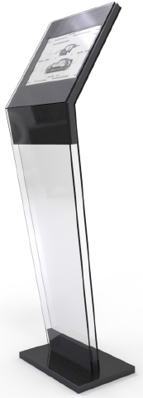
Electronic Standee - Hardware
Device: iPad Pro 12.9 inch
Resolution: 2732 x 2048 px，264 ppi

